Slide 1
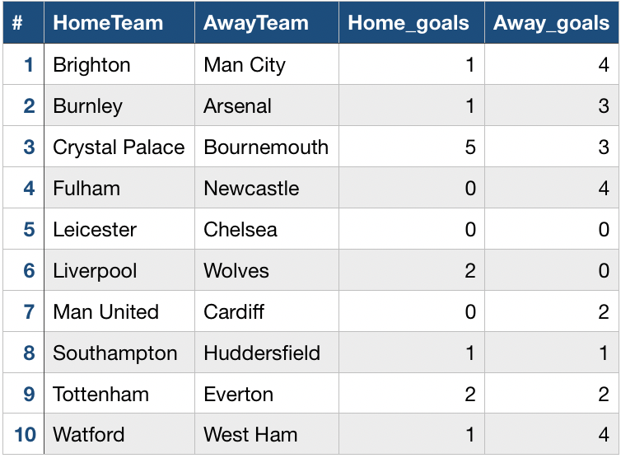
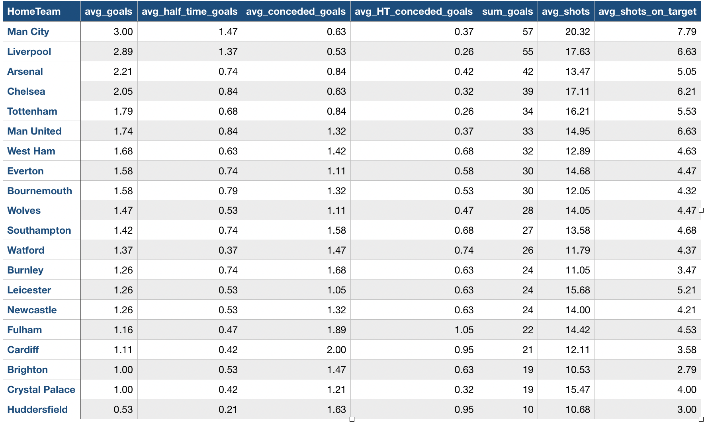
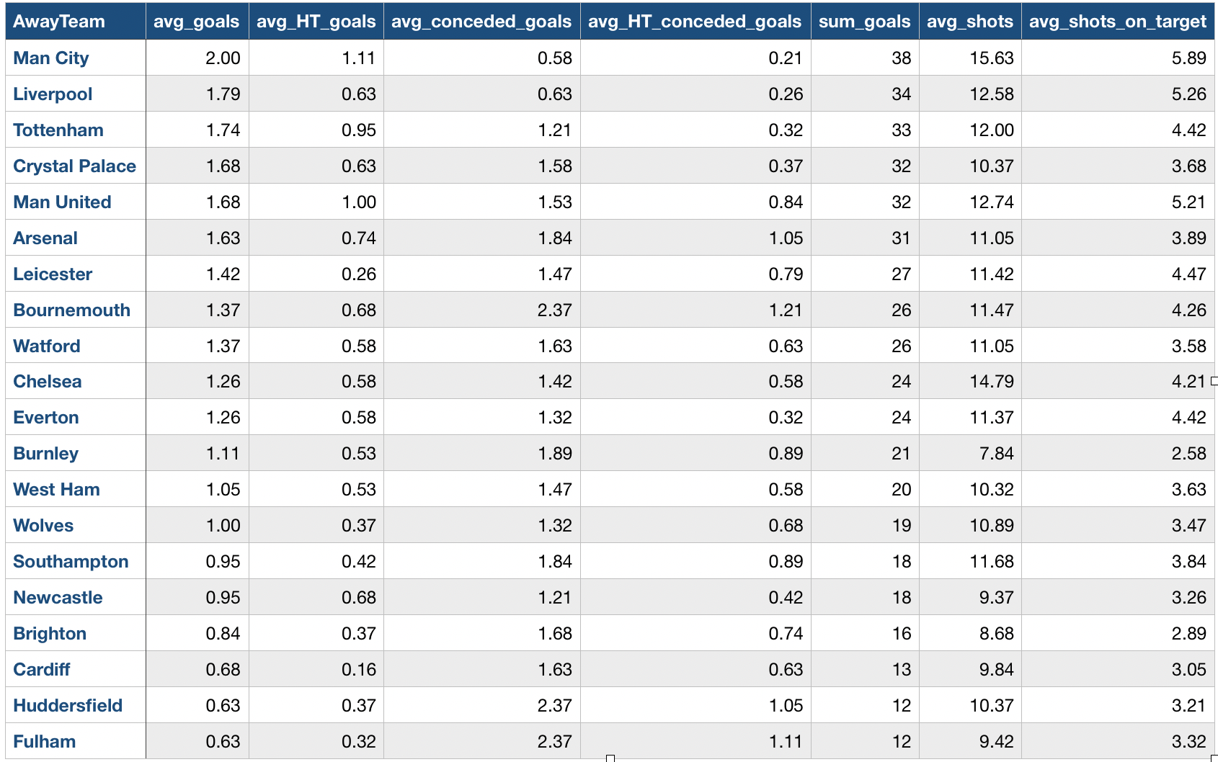
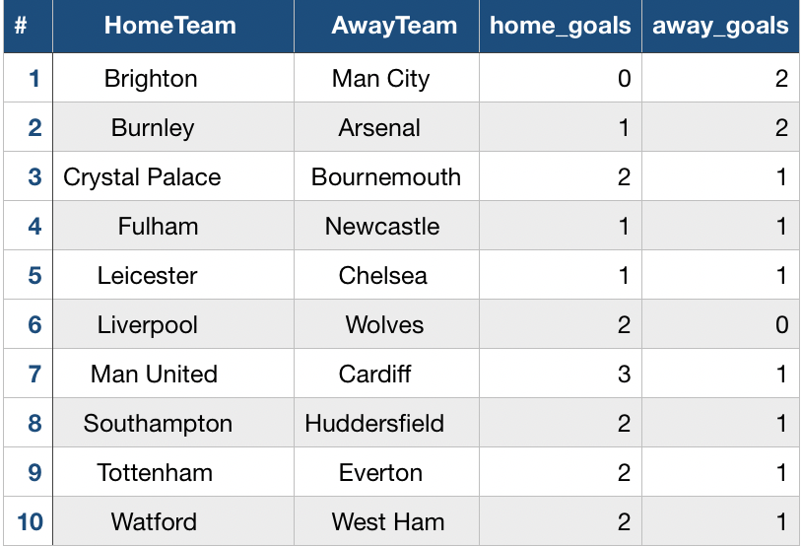
AIT580 Project Summary
Kamil Ismailov
INTRODUCTION
PREDICTION MODEL
The dataset which I chose contains information about the results of Premier League soccer tournament of season 2018-2019. The unit of analysis is an amount of scored and conceded goals because it is the most important element of the game.
The best way to predict the results of soccer matches is to use Poisson distribution.
The regression model formula:
log(L) = mu + home + team_{i} + opponent_{j}
mu - the overall mean number of goals;
home - the effect on the number of goals a home team;
team_{i} - the effect of team number i;
opponent_{j} - the effect of team j
A simulation of the last 10 games is performed by using the prediction model and compare it with the real results to check the accuracy of the Poisson model. According to Tables 3 and 4, if we consider only the outcome of the match (win, draw, lose), half of the predicted results match with actual results. Only one predicted match has the same score (Liverpool 2-0 Wolves).
Table 4. Actual results
CONCLUSION
The summary statistics give some enlightenment on the champion's winning. Manchester City soccer club has almost the best characteristics in all categories. They scored more and conceded less, which can imply they had both good attack and defense.
According to the simulation of the last 10 games, the Poisson model based on the results of the 370 matches has 50% accuracy, which is fair enough. Nowadays, many factors could be affected by match results. To make a prediction model more accurate, we need to include all relevant factors related to the soccer match.
Table 1. Home Team Performance Summary Statistics
Table 2. Away Team Performance Summary Statistics
Table 3. Predicted results

